Slide 1


APPLIED DATA SCIENCE CAPSTONE
ANAS BELAYDI

Slide 2
OUTLINE
EXECUTIVE SUMMARY
INTRODUCTION
METHODOLOGY
RESULTS
CONCLUSION
APPENDIX

Slide 3
EXECUTIVE SUMMARY
In this capstone project, we will predict if the SpaceX Falcon 9 first stage will land successfully using several machine learning classification algorithms. The main steps in this project include:
Data collection, wrangling, and formatting
Exploratory data analysis
Interactive data visualization
Machine learning prediction
In the visualization phase, graphs shows that some features of the rocket launches have strong correlation than others with the outcome of the launches success or failure.
For the prediction, It's concluded that decision tree may be the best machine learning algorithm to predict if the Falcon 9 first stage will land successfully.

Slide 4
2. INTRODUCTION
SpaceX advertises Falcon 9 rocket launches on its website with a cost of 62 million dollars; other providers cost upward of 165 million dollars each, much of the savings is because SpaceX can reuse the first stage. Therefore if we can determine if the first stage will land, we can determine the cost of a launch. This information can be used if an alternate company wants to bid against SpaceX for a rocket launch.
Most unsuccessful landings are planned. Sometimes, SpaceX will perform a controlled landing in the ocean.
The main question that we are trying to answer is :
For a given set of features about a Falcon 9 rocket launch, will the first stage of the rocket land successfully?

Slide 5
METHODOLOGY

Slide 6
3. METHODOLOGY
Executive Summary :​
Data collection methodology:
There are two source that we will use to collect data needed :
Source 1 : Make a get request to the SpaceX public API, to collect data
Source 2 : Performing web scraping to collect Falcon 9 historical launch records from a Wikipedia page titled `List of Falcon 9 and Falcon Heavy launches`
Perform data wrangling :
Delete uneeded columns
Dealing with missing values
Feature Ingenieuring
Perform exploratory data analysis (EDA) using visualization and SQL
Perform interactive visual analytics using Folium and Plotly Dash
Perform predictive analysis using classification models
Tuned models using GridSearchCV to get the best performance

Slide 7
Data Collection Overview
Data collection process involved a combination of two sources :
Api requests from Space X public API
web scraping data from a table in Space X’s Wikipedia entry.
Space X API Data Columns | Wikipedia Webscraping Columns
FlightNumber , Date , BoosterVersion , PayloadMass , Orbit , LaunchSite , Outcome , Flight , GriFins , Reused , Legs , LandingPad , Block , ReusedCount , Serial , Longitude , Latitude | Flight No , Launch Site , PayloadMass , Orbit , Custumer , Launch outcome , Version , Booster , Booster landing , Date , Time

Slide 8
Data Collection– SpaceX API
Steps followed to extract data using SpaceX API
 | STEP | EXPLANATION
1 | Request (SpaceX APIs) | Send an HTTP request to the SpaceX API to retrieve data about launches. The API provides JSON data containing information like launch site, booster version, and payload data.
2 | .JSON file + Lists(Launch Site, Booster Version, Payload Data) | Parse the JSON response and extract the relevant data, which may include lists for launch sites, booster versions, and payload details.
3 | Json_normalize to DataFrame data from JSON | Convert the JSON data into a pandas DataFrame using the json_normalize function. This transforms the nested structure of the JSON data into a more structured DataFrame.
4 | Dictionary relevant data | Select the specific columns or data points from the DataFrame that are relevant for your analysis.
5 | Cast dictionary to a DataFrame | Convert the dictionary containing the relevant data into a new DataFrame. This ensures that the data is in a consistent format for further analysis.
6 | Filter data to only include Falcon 9 launches | Apply filters to the DataFrame to select only the rows corresponding to Falcon 9 launches.
7 | Replace missing PayloadMass values with mean | Handle missing values in the PayloadMass column by replacing them with the mean value of that column. This helps ensure data consistency and completeness.
Link to the NoteBook on GitHub

Slide 9
Data Collection– Web Scraping
Steps followed to extract data using Web Scraping
 | STEP | EXPLANATION
1 | Request Wikipedia HTML | Send an HTTP request to the SpaceX Wikipedia page to retrieve the HTML content.
2 | BeautifulSoup HTML5lib Parser | Parse the HTML content using the BeautifulSoup library with the HTML5lib parser. This converts the HTML into a structured format that can be easily manipulated.
3 | Find launch info HTML table | Use BeautifulSoup to locate the HTML table containing the launch information. This might involve searching for specific tags or attributes within the HTML structure.
4 | Cast dictionary to DataFrame | Convert the extracted data into a pandas DataFrame. This provides a structured and efficient way to work with the data.
5 | Iterate through table cells to extract data to dictionary | Iterate through the table cells to extract the desired data and store it in a dictionary. This dictionary will represent a single row of the DataFrame.
6 | Create dictionary | Create a list of dictionaries, where each dictionary represents a row of data extracted from the table. This list can then be converted into a pandas DataFrame.
Link to the NoteBook on GitHub

Slide 10
Data wrangling
In this step, we'll create a new target variable by categorizing the 'outcome' values into two groups.
The first group of outcomes means that the landing was successful (with a value is 1), and the second group means that the landing failed (with a value 0 )
While the dataset has eight distinct outcomes, we'll simplify this to a binary classification problem.
OUTCOME VALUE | CLASS
True ASDS True RTLS True Ocean | 1
None None False ASDS False Ocean None ASDS False RTLS | 0
The link to the NoteBook on GitHub

Slide 11
EDA with Data Visualization
Exploratory Data Analysis performed on variables Flight Number, Playload Mass, Launch Site, Orbit, Class and year. Visualizations help to compare relationships between variables to decide if a relationship existes so that they could be used in training the machine learning model
PLOT TYPE | FEATURES | TITLE
Scatter plot | Flight nulber , PayloadMass ,Class | Flight Number vs Payload Mass
Scatter plot | Launch site, Flight number, Class | Relationship between launch sites and their Flight number
Scatter plot | Payload Mass, Launch site, Class | RelationShi^between launch sites and their payload Mass
bar plot | Orbit, Success rate (calculated) | Success rate by Orbit
Scatter plot | Orbit type, Flight Number, Class | Relationship between Flight Number and orbit type
Scatter plot | PayLoadMass, orbit type, Class | Relationship between Payload Mass and orbit type
Lineplot | Years, Success rate(calculated) | Success rate over years
The link to the NoteBook on GitHub

Slide 12
EDA with SQL
Performed SQL queries:
Displaying the names of the unique launch sites in the space mission
Displaying 5 records where launch sites begin with the string ‘CCA’
Displaying the total payload mass carried by boosters launched by NASA (CRS)
Displaying average payload mass carried by booster version F9 v1.1
Listing the date when the first successful landing outcome in ground pad was achieved
Listing the names of the boosters which have success in drone ship and have payload mass greater than 4000 but less than 6000
Listing the total number of successful and failure mission outcomes
Listing the names of the booster versions which have carried the maximum payload mass
Listing the failed landing outcomes in drone ship, their booster versions and launch site names for the months in year 2015
Ranking the count of landing outcomes (such as Failure (drone ship) or Success (ground pad)) between the date 2010-06-04 and 2017-03-20 in descending ord
The link to the NoteBook on GitHub

Slide 13
Build an Interactive Map with Folium
Markers of all Launch Sites
- Added Marker with Circle, Popup Label and Text Label of NASA Johnson Space Center using its latitude and longitude coordinates as a start location. - Added Markers with Circle, Popup Label and Text Label of all Launch Sites using their latitude and longitude coordinates to show their geographical locations and proximity to Equator and coasts.
Coloured Markers of the launch outcomes for each Launch Site
Added coloured Markers of success (Green) and failed (Red) launches using Marker Cluster to identify which launch sites have relatively high success rates.
Distances between a Launch Site to its proximities
- Added coloured Lines to show distances between the Launch Site KSC LC-39A (as an example) and its proximities like Railway, Highway, Coastline and Closest City.
The link to the NoteBook on GitHub

Slide 14
Build a Dashboard with Plotly Dash
Elements used in the Dashboard :
ELEMENT | EXPLANATION
Launch Sites Dropdown List: | Enable Launch Site selection
Pie Chart showing Success Launches (All Sites/Certain Site | Added a pie chart to show the total successful launches count for all sites and the Success vs. Failed counts for the site, if a specific Launch Site was selected.
Slider of Payload Mass Range: | Added a slider to select Payload range.
Scatter Chart of Payload Mass vs. Success Rate for the different Booster Versions | Added a scatter chart to show the correlation between Payload and Launch Success.
Link to Dash app

Slide 15
Predictive analysis (Classification)
Creating a NumPy array from the column “Class” in data
Standardizing the data with StandardScaler, then fitting and transforming it
Splitting the data into training and testing sets with train_test_split function
Creating a GridSearchCV object with cv = 10 to find the best parameters
Applying GridSearchCV on LogReg, SVM, Decision Tree, and KNN models
Calculating the accuracy on the test data using the method .score() for all models
Examining the confusion matrix for all models
Finding the method performs best by examining the Jaccard_score and F1_score metrics
Link to the NoteBook on GitHub

Slide 16
Results
Explaratory data analysis results
Interactive analytics demo on screenshots
Predictive analysis results

Slide 17
EDA with Visualization

Slide 18
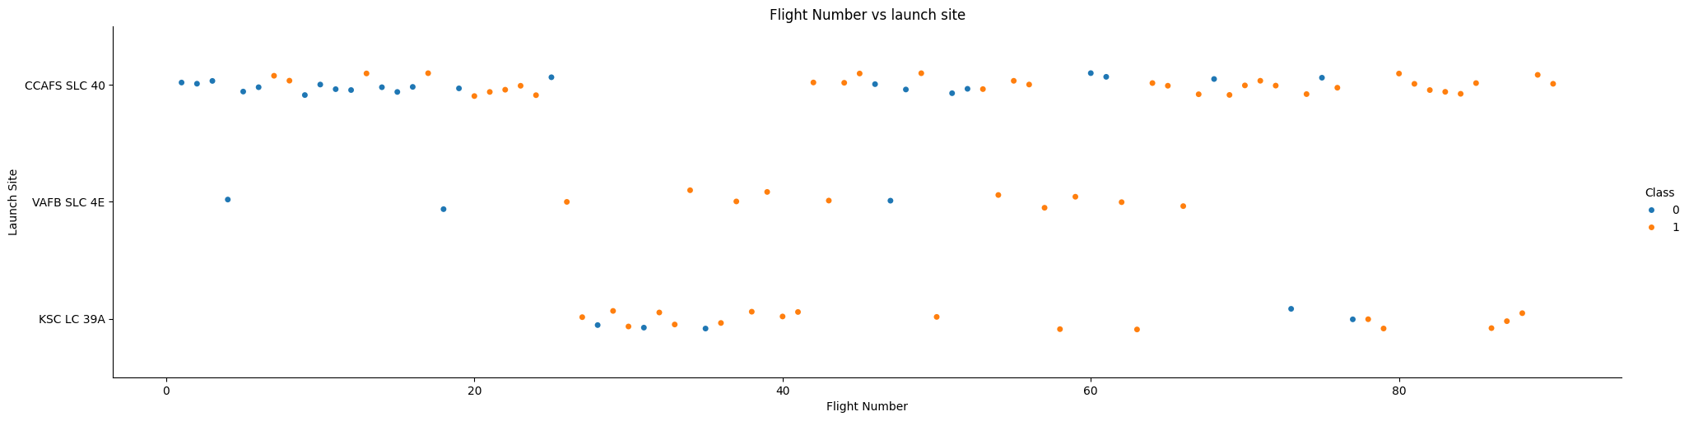
EDA with Data Visualization
The relationship between FlightNumber and launch site to define the success of landing
Launch Site Frequency: "CCAFS SLC 40" is the most frequently used launch site, followed by "KSC LC 39A" and "VAFB SLC 4E".
Launch Success: There seems to be a general trend where later flight numbers from "KSC LC 39A" and "VAFB SLC 4E" have a higher success rate (indicated by the blue dots). However, this trend is less clear for "CCAFS SLC 40".
Launch Site Variation: The spread of data points for "CCAFS SLC 40" suggests more variation in launch outcomes compared to the other two sites.

Slide 19
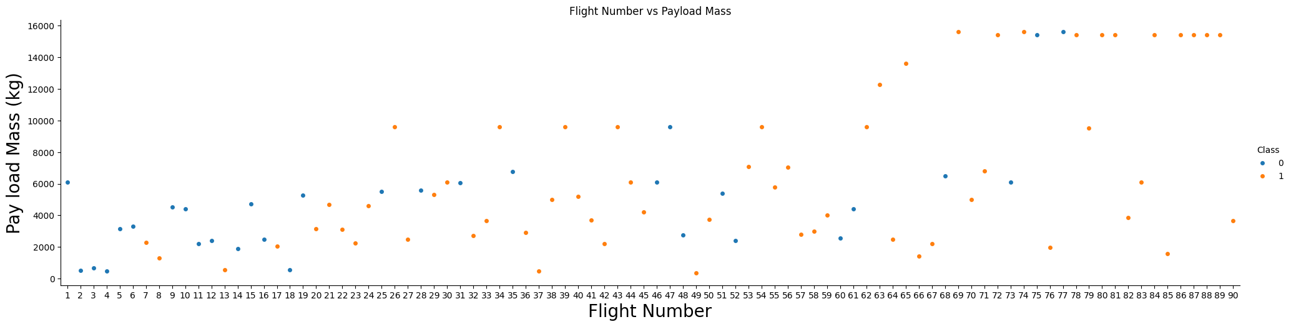
EDA with Data Visualization
The relationship between FlightNumber and PayloadMass to define the success of launding
By overlaying the launch outcome on the plot of FlightNumber vs. PayloadMass, a pattern emerges. As the FlightNumber increases, the likelihood of the first stage landing successfully also increases. Conversely, as the PayloadMass increases, the likelihood of the first stage returning successfully decreases.
This suggests that both the number of launch attempts and the mass of the payload play significant roles in determining the success of the first stage's return.

Slide 20
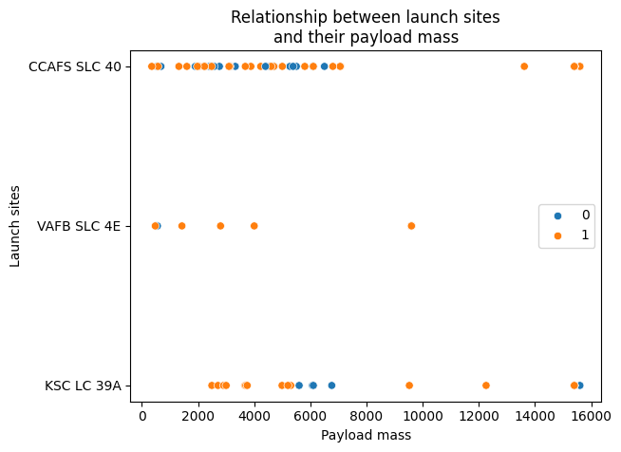
EDA with Data Visualization
The relationship between Payload and Launch Site
Observing Payload Vs. Launch Site scatter point chart shows that in the VAFB-SLC 4E Launch-site, there are no rockets launched for heavy payload Mass (greater than 10000).

Slide 21
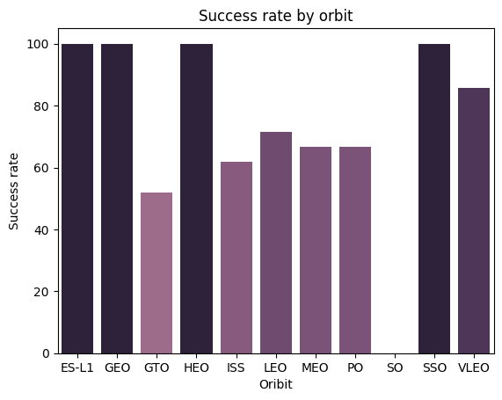
EDA with Data Visualization
Visualize the relationship between success rate of each orbit type
Analyzing the ploted bar chart indicates that ES-L1 , GEO , HEO , and SSD, orbits have the highest success rate (100%)

Slide 22
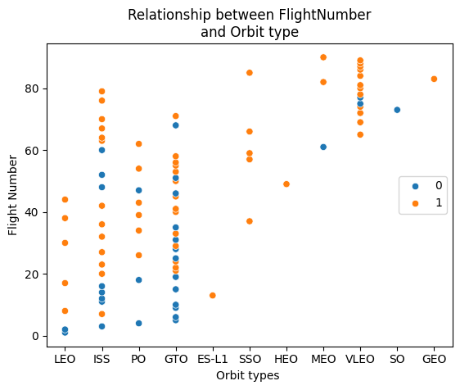
EDA with Data Visualization
The relationship between FlightNumber and Orbit type.
The LEO orbit the Success appears related to the number of flights; on the other hand, there seems to be no relationship between flight number when in GTO orbit.

Slide 23
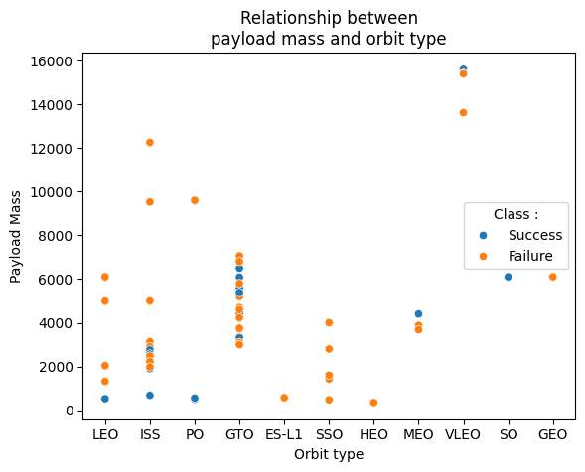
EDA with Data Visualization
The relationship between Payload mass and Orbit type
With heavy payloads the successful landing or positive landing rate are more for Polar,LEO and ISS.
However for GTO we cannot distinguish this well as both positive landing rate and negative landing(unsuccessful mission) are both there here

Slide 24
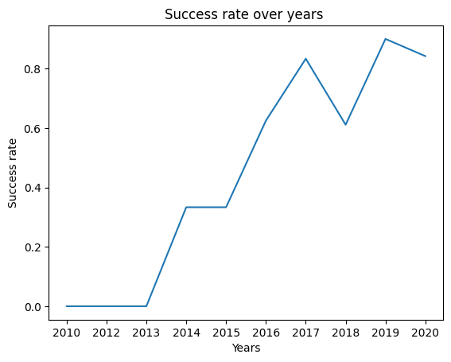
EDA with Data Visualization
Success rate over years
We can observe that the success rate since 2013 kept increasing till 2017 (stable in 2014) and after 2015 it started increasing.

Slide 25
EDA with SQL

Slide 26
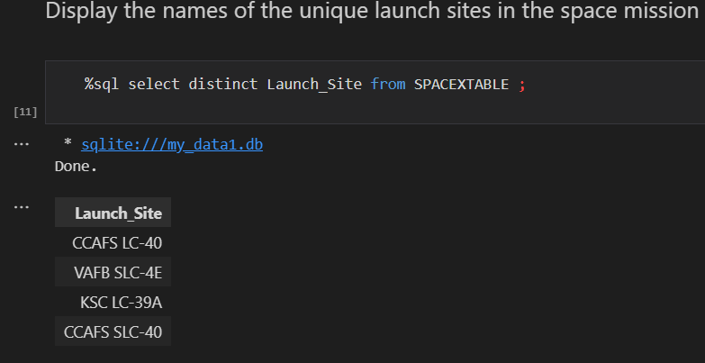
EDA with SQL
All launch site names
Displaying the names of the unique launch sites in the space mission

Slide 27
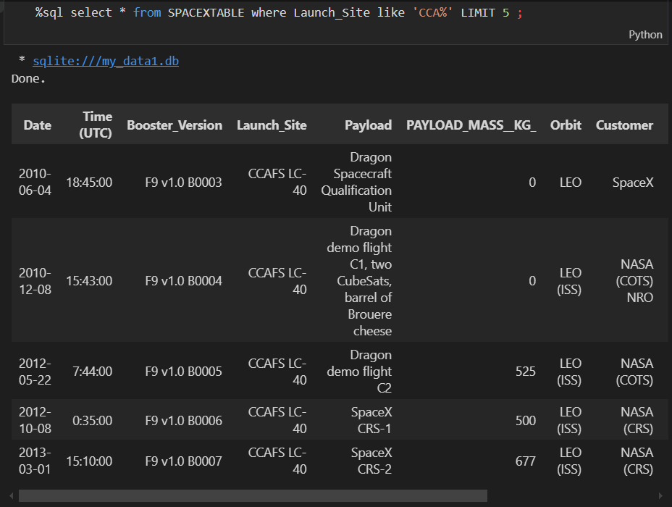
EDA with SQL
Launch site names begin with ‘CCA’
Displaying 5 records where launch sites begin with the string ‘CCA’

Slide 28
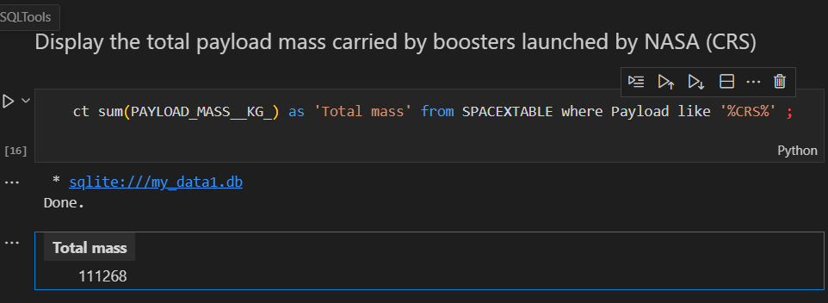
EDA with SQL
Total payload mass
Displaying the total payload mass carried by boosters launched by NASA (CRS)

Slide 29
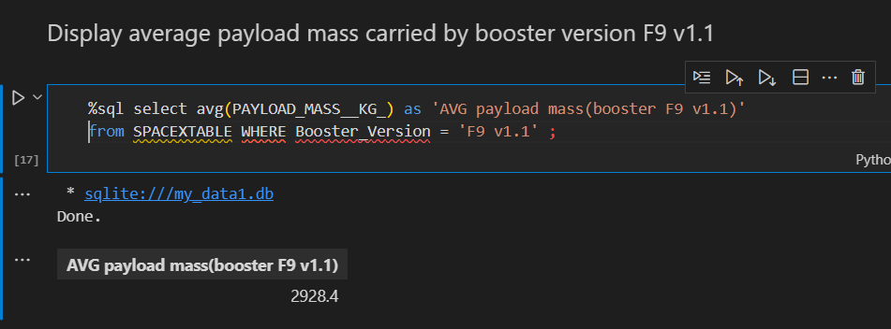
EDA with SQL
Average payload mass by F9 v1.1
Displaying average payload mass carried by booster version F9 v1.1

Slide 30
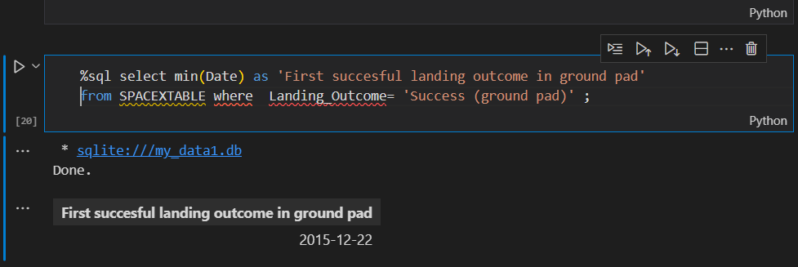
EDA with SQL
First successful ground landing date
Listing the date when the first successful landing outcome in ground pad was achieved

Slide 31
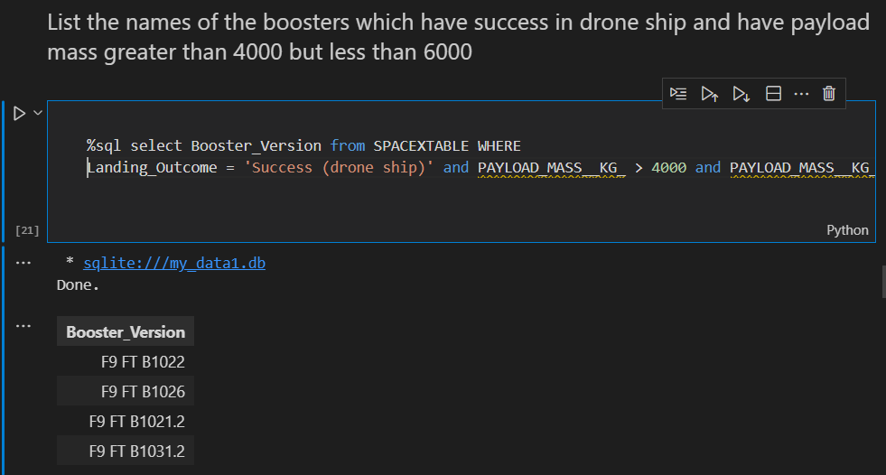
EDA with SQL
Successful drone landing with payload between 4000 and 6000
Listing the names of the boosters which have success in drone ship and have payload mass greater than 4000 but less than 6000

Slide 32
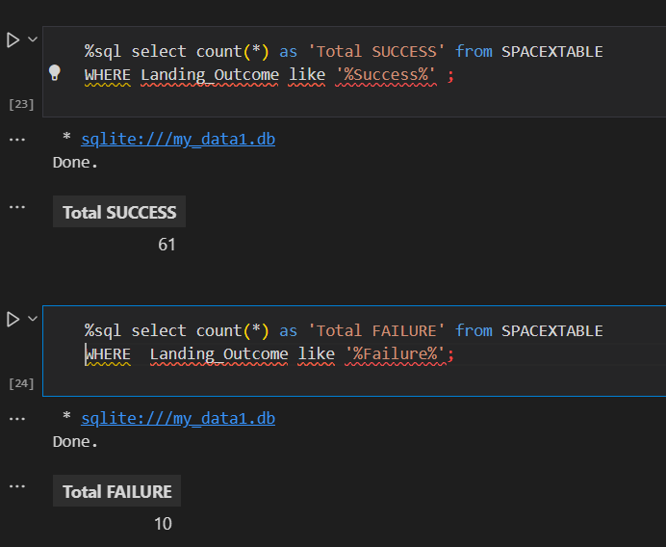
EDA with SQL
Total number of successful and failure mission outcomes
Listing the total number of successful and failure mission outcomes
Total successful mission outcomes | Total failure mision outcomes
61 | 10

Slide 33
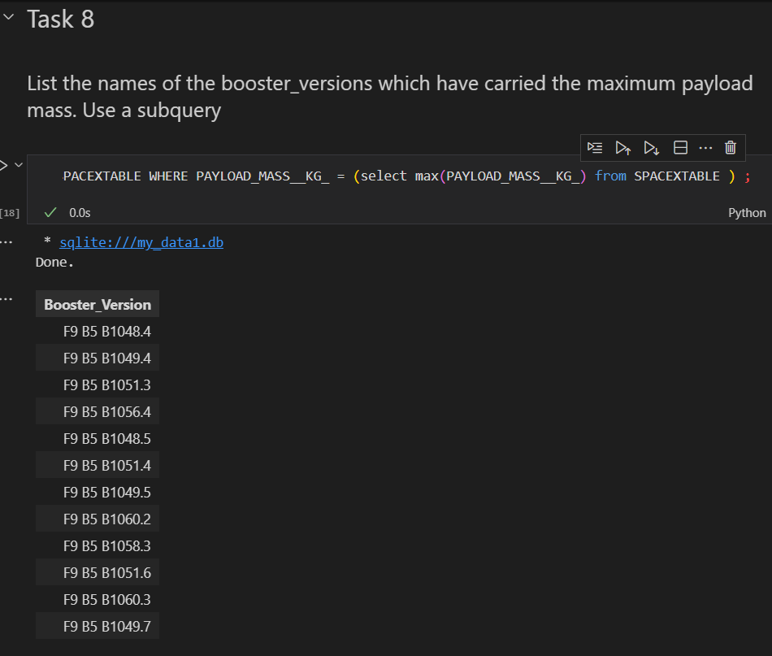
EDA with SQL
Boosters carried maximum payload
Listing the names of the booster versions which have carried the maximum payload mass

Slide 34
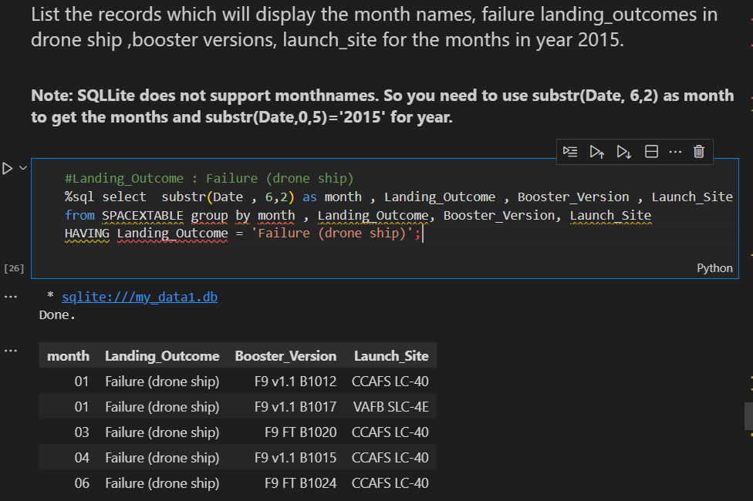
EDA with SQL
2015 launch records
Listing the failed landing outcomes in drone ship, their booster versions and launch site names for the months in year 2015

Slide 35
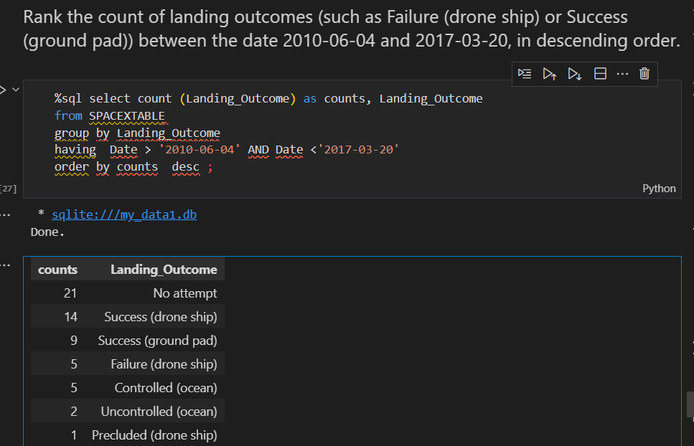
EDA with SQL
Rank success count between 2010-06-04 and 2017-03-20
Ranking the count of landing outcomes (such as Failure (drone ship) or Success (ground pad)) between the date 2010-06-04 and 2017-03-20 in descending ord

Slide 36
Interactive map with Folium

Slide 37
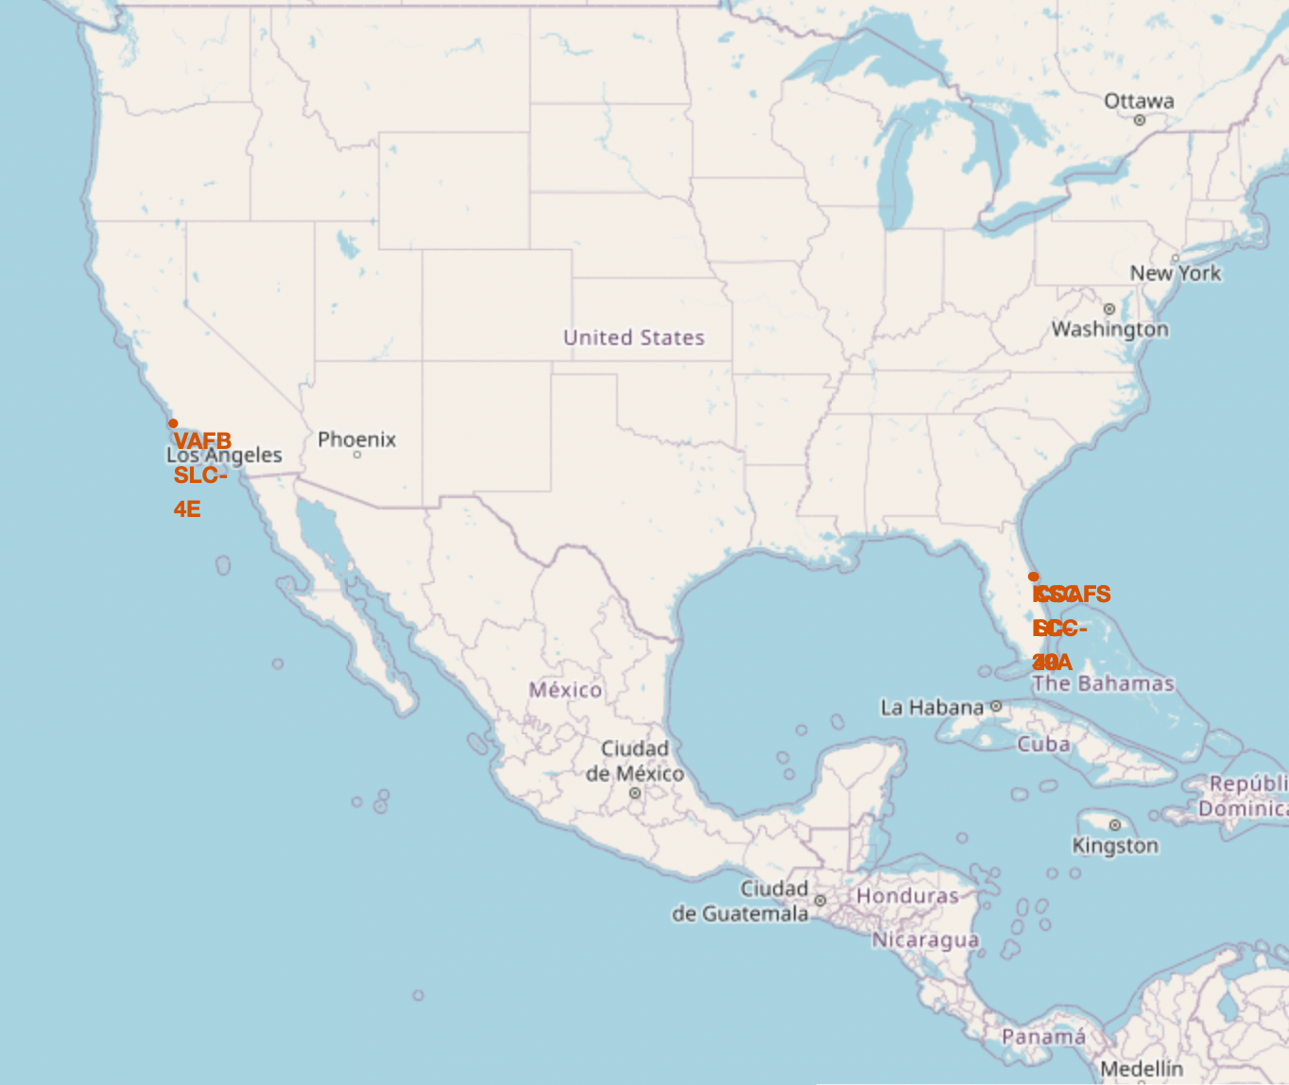
All launch sites location markers on a global map
Most of Launch sites are in proximity to the Equator line. The land is moving faster at the equator than any other place on the surface of the Earth. Anything on the surface of the Earth at the equator is already moving at 1670 km/hour. If a ship is launched from the equator it goes up into
space, and it is also moving around the Earth at the same speed it was moving before launching. This is because of inertia.
This speed will help the spacecraft keep up a good enough speed to stay in orbit.
All launch sites are in very close proximity to the coast, while launching rockets towards the ocean it minimises the risk of having any debris dropping or exploding near people.

Slide 38
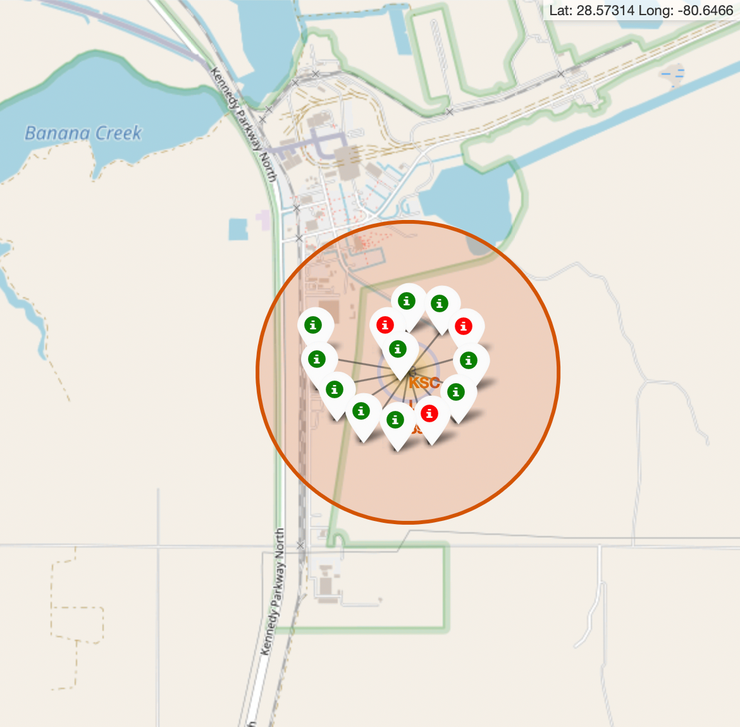
Colour-labeled launch records on the map
• From the colour-labeled markers we should be able to easily identify which launch sites have relatively high success rates.
Green Marker = Successful Launch
Red Marker = Failed Launch
• Launch Site KSC LC-39A has a very high Success Rate

Slide 39
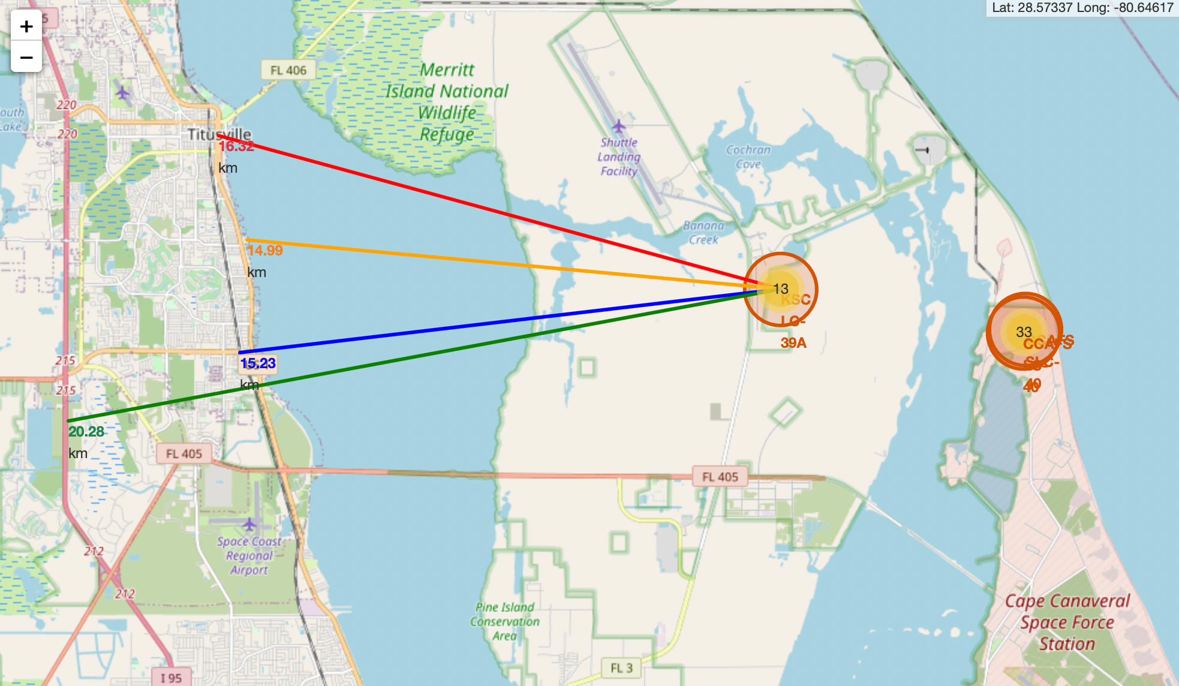
Distance from the launch site KSC LC-39A to its proximities
From the visual analysis of the launch site KSC LC-39A we can clearly see that it is:
- relative close to railway (15.23 km)
- relative close to highway (20.28 km)
relative close to coastline (14.99 km)
• Also the launch site KSC LC-39A is relative close to its closest city Titusville (16.32 km).
• Failed rocket with its high speed can cover distances like 15-20 km in few seconds. It could be potentially dangerous to populated areas

Slide 40
Build a Dashboard with Plotly Dash

Slide 41
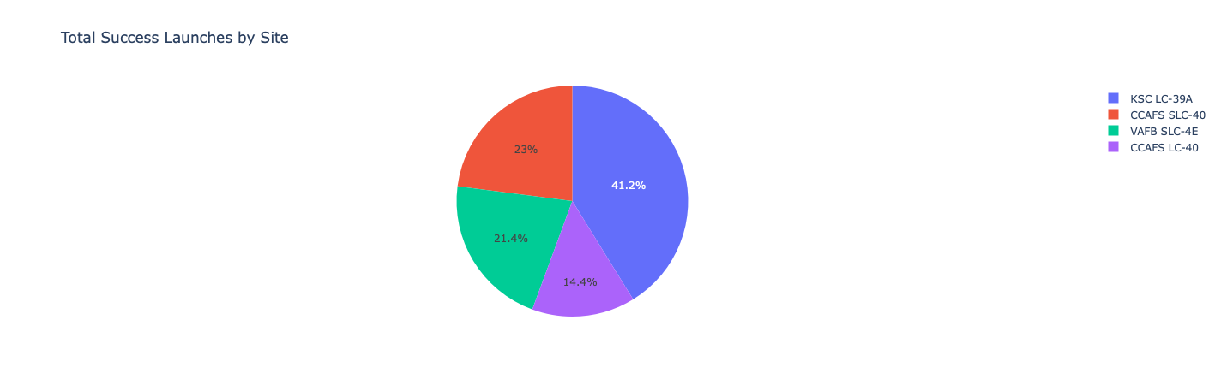
Launch success count for all sites
The chart cleary shows that from all the sites, KSC LC 39A has the most successful lanches

Slide 42
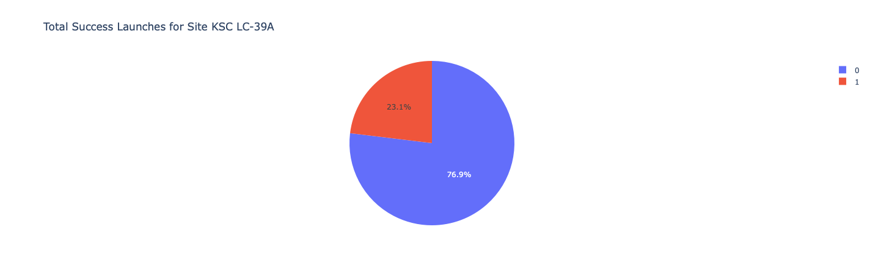
Launch site with highest launch success ratio
KSC LC-39A has the highest launch success rate (76.9%) with 10 successful and only 3 failed landings

Slide 43
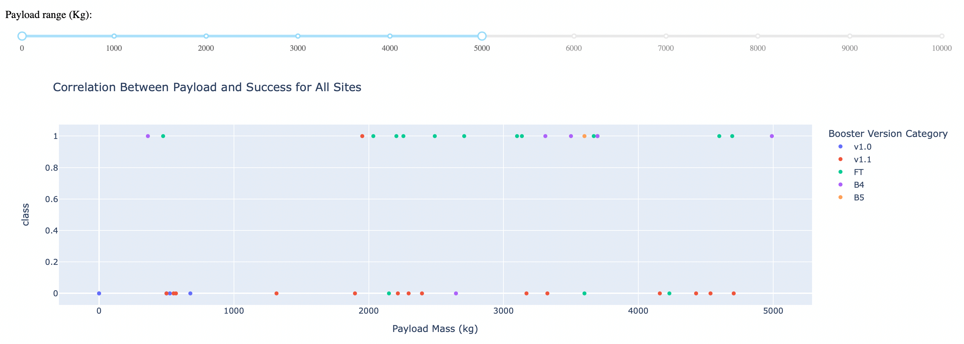
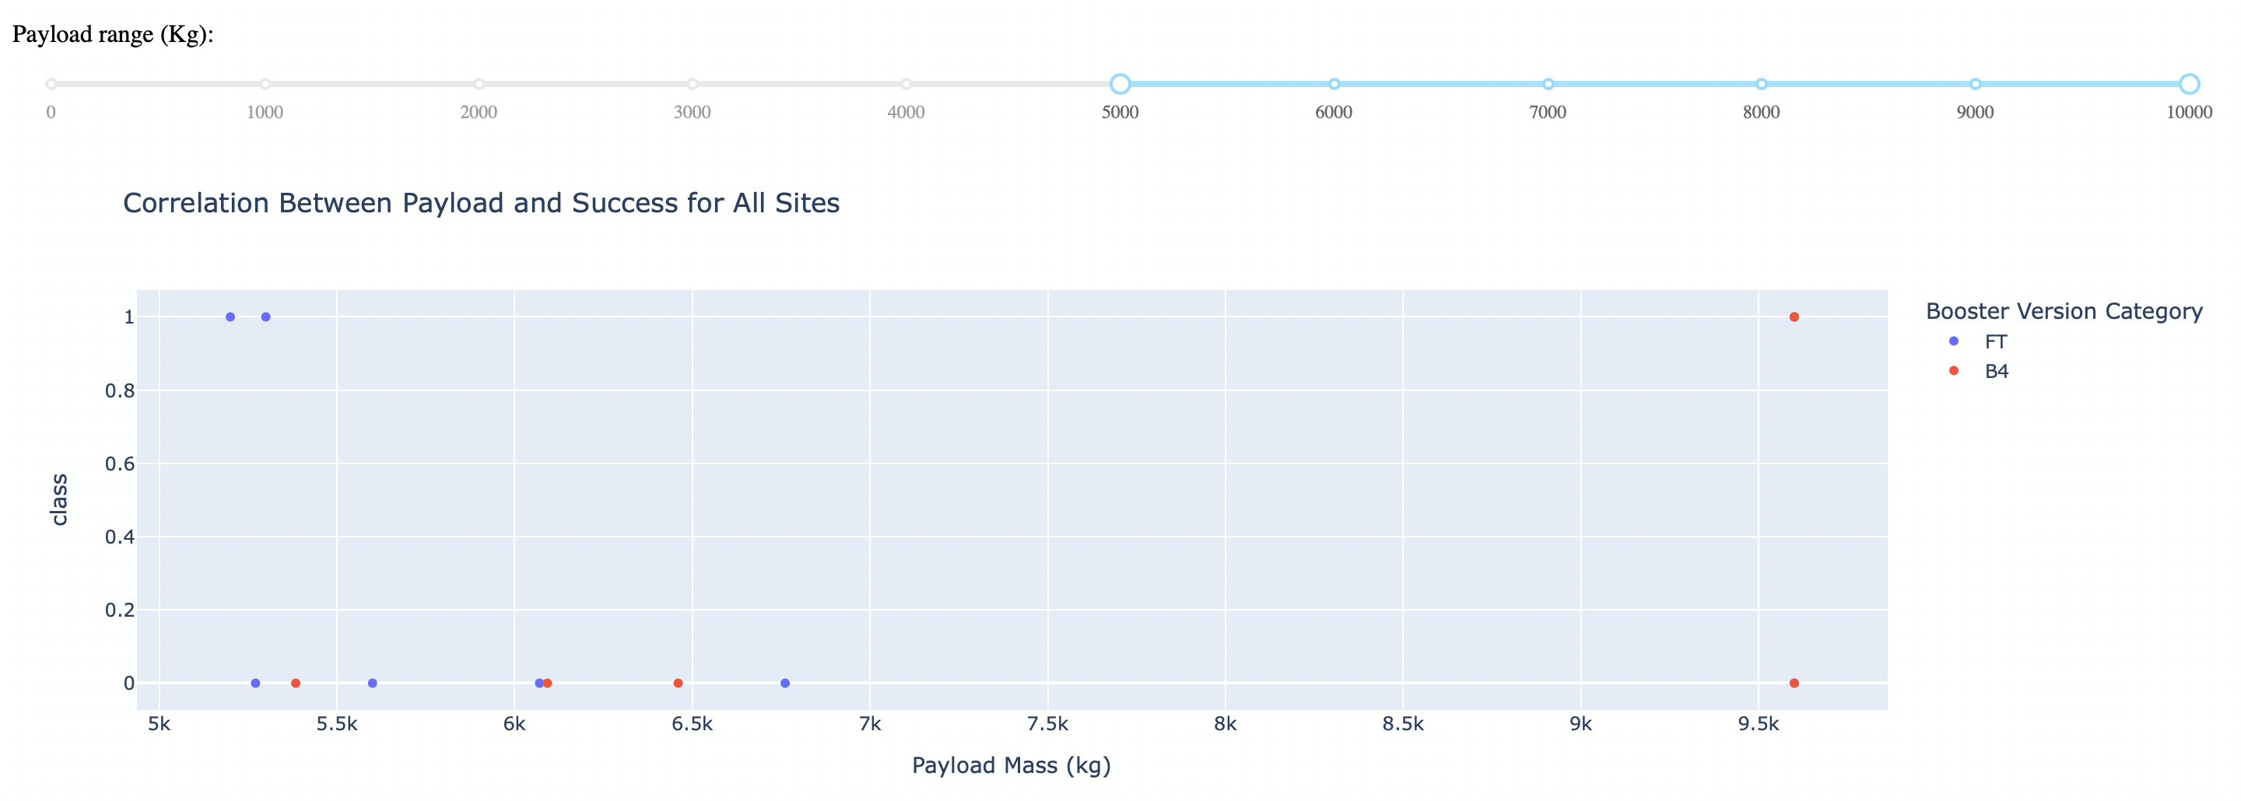
Payload Mass vs. Launch Outcome for all sites
The charts show that payloads between 2000 and 5500 kg have the highest success rate.

Slide 44
Predictive analysis (Classification)

Slide 45
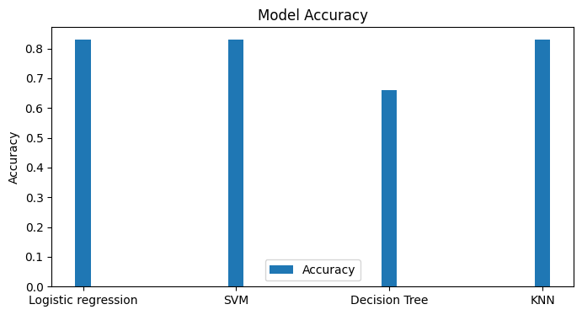
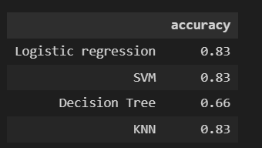
Classification Accuracy
The models had virtually the same accuracy on the test set at 83.33%accuracy, except the decision tree classifier with 66%.
It should be noted that test size is small at only sample size of 18.
This can cause large variance in accuracy results, such as those in Decision Tree Classifier model
We likely need more data to determine the best model.

Slide 46
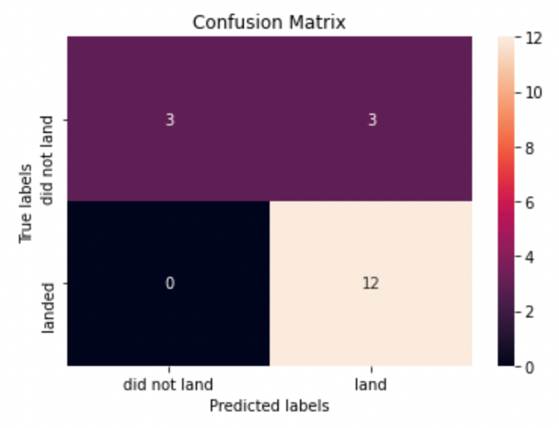
Confusion Matrix
Since all models performed the same for the test set, the confusion matrix is the same across all models. (except Decision Tree)
The models predicted 12 successful landings when the true label was successful landing
The models predicted 3 unsuccessful landings when the true label was unsuccessful landing.
The models predicted 3 successful landings when the true label was unsuccessful landings (false positives).
Our models make good predictions of successful landings.

Slide 47
Conclusions
Decision Tree, KNN and SVM Models are the best algorithms for this dataset.
Launches with a low payload mass show better results than launches with a larger payload mass.
Most of launch sites are in proximity to the Equator line and all the sites are in very close proximity to the coast.
The success rate of launches increases over the years.
KSC LC-39A has the highest success rate of the launches from all the sites.
Orbits ES-L1, GEO, HEO and SSO have 100% success rate

Slide 48
Appendix
GitHub repository url :
https://github.com/anasheros/Applied_data_science
Special Thanks to All Instructors:
IBM Data Science Professional Certificate | Coursera

